Slide 1
Montecarlo techniques
From random walk to simulated annealing

Slide 2
Summary
A few reminders of statistics
Average, variance, correlation
Central limit theorem
Pseudo-random numbers
Metropolis algorithm
Random walk
Detailed balance
Self-correlation
Simulated annealing
Travelling salesman

Slide 3
Mean and variance: one variable

Slide 4
Two variables

Slide 5


N independent variables sharing the same distribution
$Y_{N}$= X₁ + X₂ +…+ X_{N}
$Z_{N}$= (X₁ + X₂ +…+ X_{N})/N
$W_{N}$= (X₁ + X₂ +…+ X_{N})/$\sqrt{N}$
$σ_{Y_{N}}^{2}$= N $σ_{X}^{2}$
$σ_{Z_{N}}^{2}$= $σ_{X}^{2}$/N
$σ_{W_{N}}^{2}$= $σ_{X}^{2}$

Slide 6
Chebyshev inequality

Slide 7
Central limit theorem
The CLT states that a gaussian distribution is reached for N→∞ even starting from
a non-gaussian distribution, as long as the original distribution has finite variance

Slide 8
Pseudo-random numbers
Goal: to generate points distributed according to a given function representing a density of probability.
It will then be «easy» to find the maximum of that function.
Linear congruential generators:
Possible problems:
Short cycles
Marsaglia planes

Slide 9
A very short cycle

Slide 12
From “Numerical recipes”, Press et al.
The routine ran0 is a Minimal Standard, satisfactory for the majority of applications, but we do not recommend it as the final word on random number generators.
Our reason is precisely the simplicity of the Minimal Standard. It is not hard to think of situations where successive random numbers might be used in a way that accidentally conflicts with the generation algorithm. For example, since successive numbers differ by a multiple of only 1.6 x 10 ⁴ out of a modulus of more than 2 x 10⁹ very small random numbers will tend to be followed by smaller than average values. One time in 10⁶ for example, there will be a value < 10⁻⁶ returned (as there should be), but this will always be followed by a value less than about 0.0168. One can easily think of applications involving rare events where this property would lead to wrong results.
ran1, uses the Minimal Standard for its random value, but it shuffles the output to remove low-order serial correlations. A random deviate derived from the jth value in the sequence, Ij, is output not on the jth call, but rather on a randomized later call, j +32 on average.

Slide 13
Transformation method
y=y(x) is a given function, then:
An example:
Viceversa: we want to find y=y(x) so that p(y) is a given f(y)

Slide 14
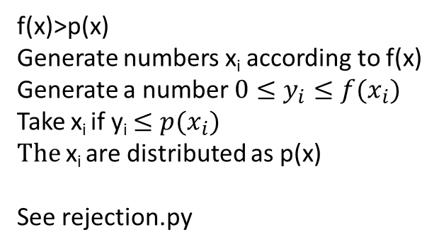
Rejection method
f(x)>p(x)
Generate numbers x_{i} according to f(x)
Generate a number $0≤y_{i}≤f(x_{i})$
Take x_{i} if y_{i} $≤p(x_{i})$
The x_{i} are distributed as p(x)
See rejection.py

Slide 15


Special technique for gaussian distributions
Is based on Maxwell distribution of energies:
$$e^{−\frac{E}{kT}}$$
$$=e^{−m v^{2}/(2 kT)}$$

Slide 16
Metropolis
x = y + r Δ

Slide 17
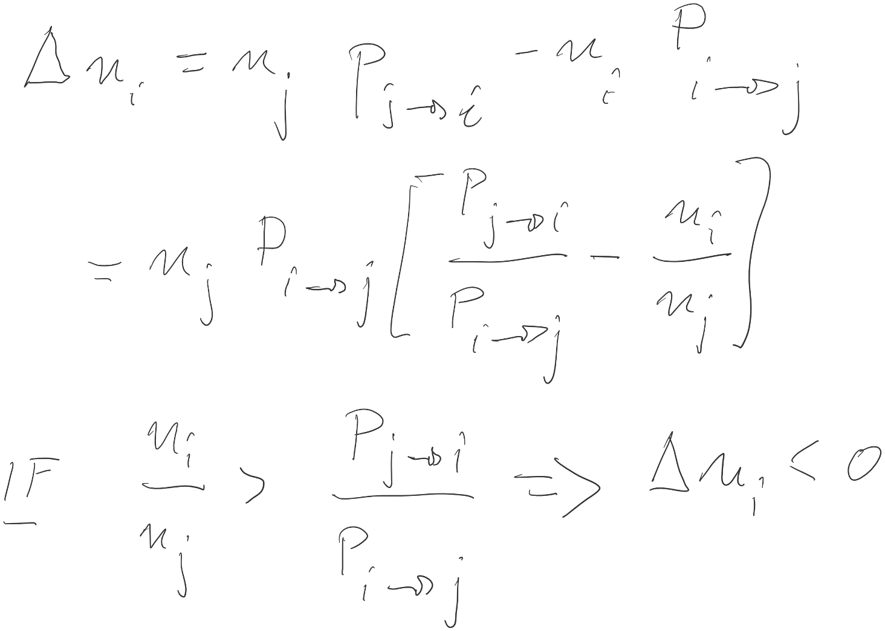
An equilibrium is reached

Slide 18
The equilibrium corresponds to the given density of probability
If f_{j} / f_{i} < 1 then
A _{i->j} = f_{j} / f_{i}
A _{j->i} = 1
A _{j->i} / A _{i->j} = f_{i} / f_{j}
If f_{j} / f_{i} > 1 then
A _{i->j} = 1
A _{j->i} = f_{i} / f_{j}
A _{j->i} / A _{i->j} = f_{i} / f_{j} again

Slide 19
Simulated annealing
To minimize E means to maximize Prob(E)
Large T: big jumps
Small T: small jumps
→ Gradually reduce T after a given number of iterations

Slide 20
Travelling salesman

Slide 22
Simple Montecarlo integration

Slide 23
Importance sampling

Slide 24
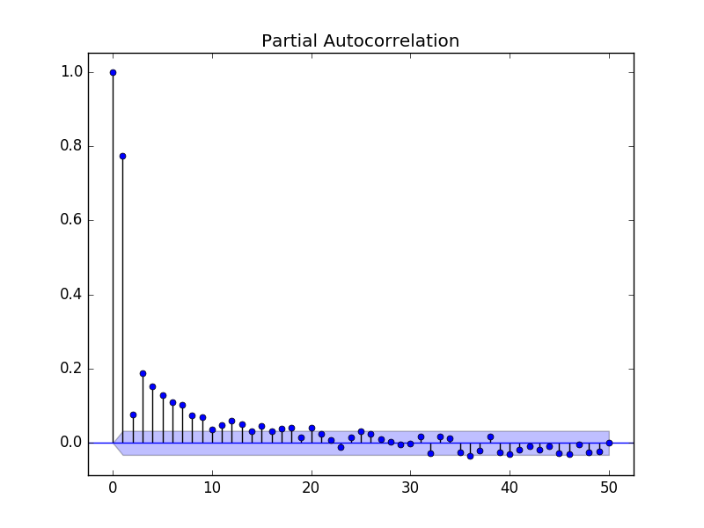
Autocorrelation function
For a discrete process with known mean and variance for which we observe n observations {X1, X2, … Xn}, an estimate of the autocorrelation may be obtained as:
for any positive integer k<n. When the true mean μ and variance σ² are known, this estimate is unbiased. If the true mean and variance of the process are not known if μ and σ² are replaced by the standard formulae for sample mean and sample variance, then this is a biased estimate.

